Slide 1

Indian Institute Of Information Technology, Kalyani
Project (5th Semester)
(CS591)
Mentored By – Mr. Anirban Lakshman

Slide 2
MEMBERS
Name Reg No. Roll No.
Akash Ramanand Rajak 435 19008
Amaan Khan 438 19011
Kumar Saurabh 470 19043
Pallav Dubey 481 19054

Slide 3
A real life application of human object detection model.
Use of Image Processing, Video Processing, Object Detection and Deep neural networks are used which are rigorous parts of modern Artificial Intelligence.
The project will focus on human object detection and count of people in an image or in a real time video through camera or some other source.
We’ve worked on three different methods and algorithms to detect a human object in order of their increasing accuracy.

Slide 4
The first one is Harr Cascade Classifier method in which classifier for some objects are predefined.
This method uses a xml file consisting of functions and definitions of Image and Video processing.
Since the most popular programming language featuring AI is Python hence it is used.
Usage of cv2 library helped linking with the xml cascade file easily.

Slide 5
An additional library Open CV is used to detect and make program understand functions related to object detection.
Some of these functions are cvtColor(), detectMultiScale(), rectangle() etc.
The program is flexible and can be used with any video extension(.mp4, .mkv, .ovi, etc.) which is taken as input for human detection.
First test video is used of a open area covering a large number of people.

Slide 6
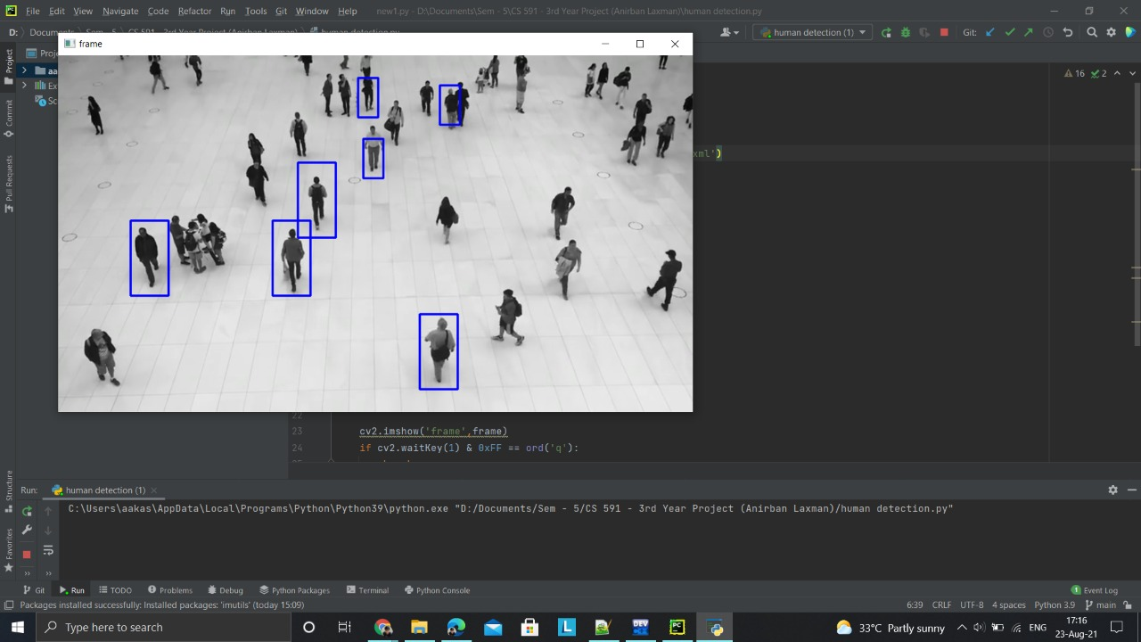

Slide 7
Further we have improved some user interfaces and added some additional features.
Used additional libraries like
  Imutils - a series of convenience functions to make basic image processing functions such as translation, rotation, resizing, skeletonization, and displaying Matplotlib images easier with OpenCV and Python.
  Argparse – this module makes it easy to write user-friendly command-line interfaces.
Also worked on the labelling of the human body detected by the program by the counter which tells us the count of the number of people at that particular instance in the video.

Slide 8
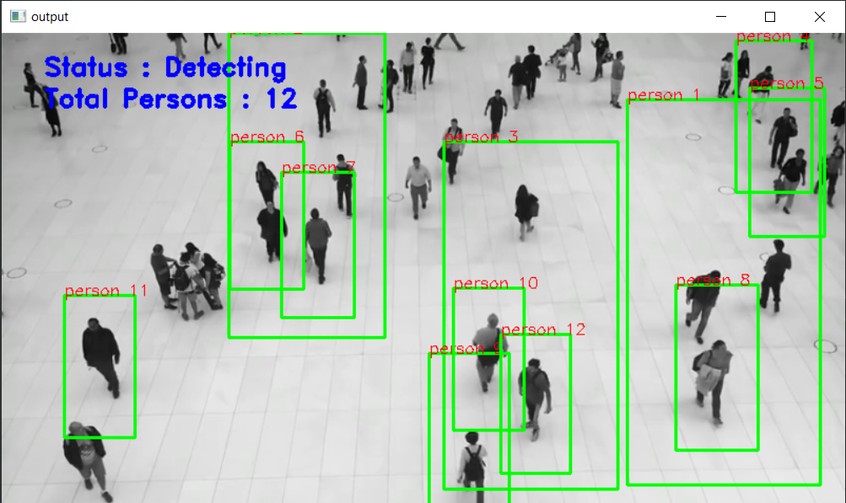
Executed the program and got the output as below with more accuracy on numbers detected and got the labelling also.

Slide 9
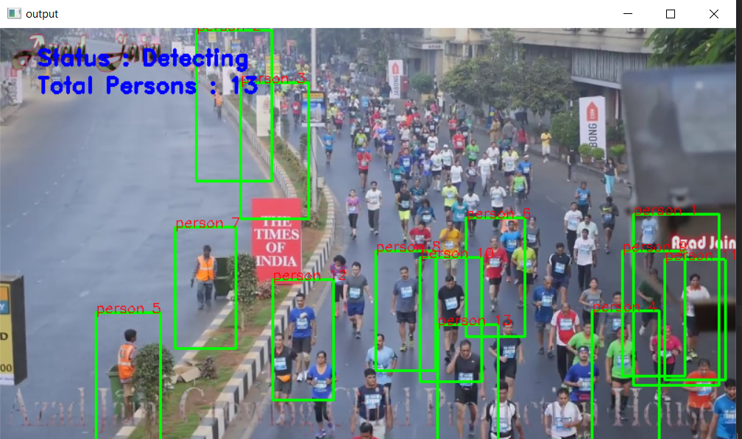

Slide 10
Added frontend part in the project. For this we used Tkinter GUI and added different buttons and labels.
Additional Libraries used:
  Tkinter – for frontend GUI window
  PIL – for adding images to the tkinter GUI window
  Messagebox from tkinter – to show any message using dialog box
  Filedialog – to select images and video using select buttons.
When we run the code, a GUI window will open with START and EXIT button on it.

Slide 11
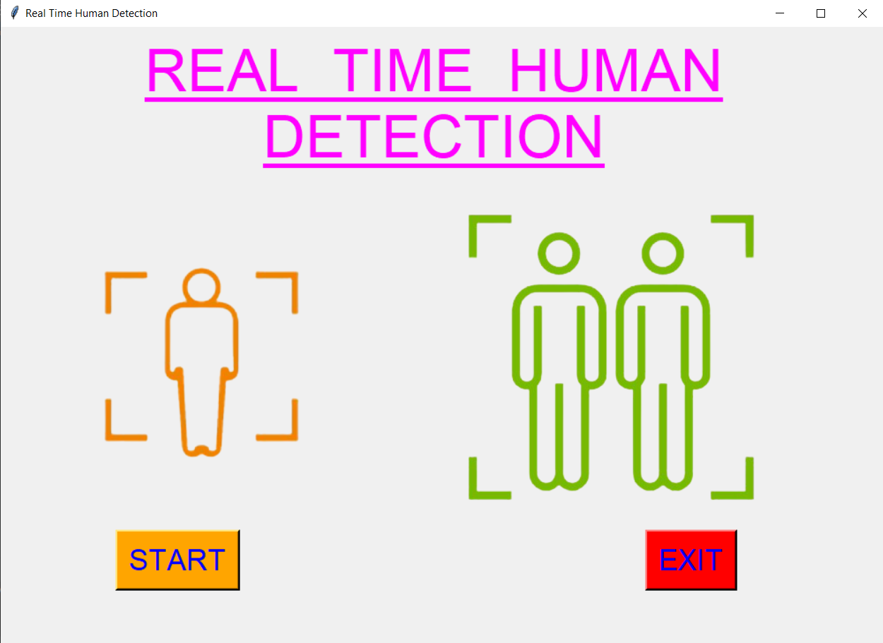

Slide 12
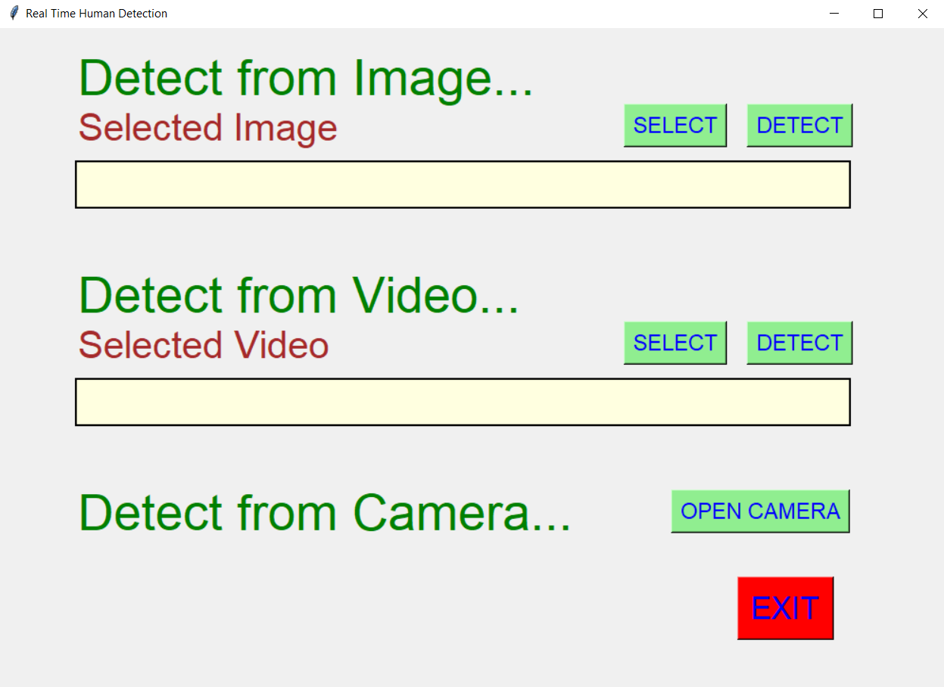

Slide 13
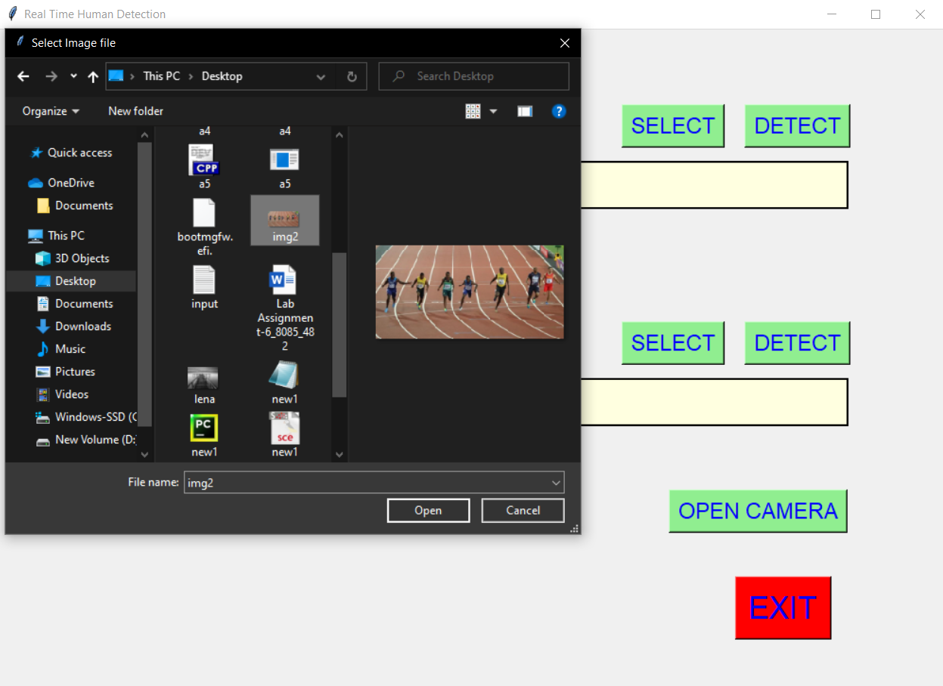
When we click on select button on image option, we get option to select image from the local system and when click on the detect button, an output image is shown which detected human and their count.

Slide 14
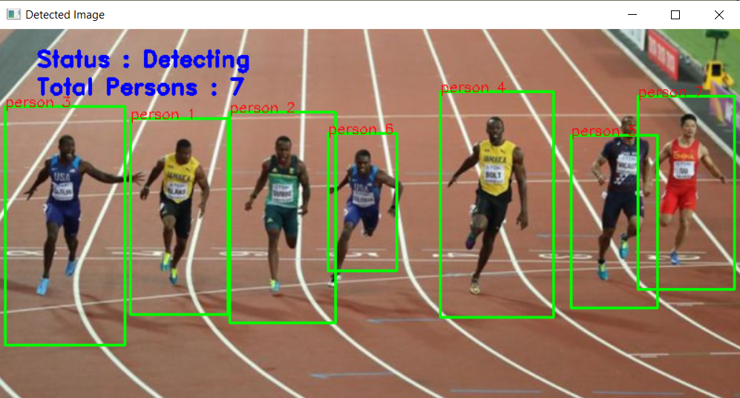
In the same way when we select video from the local system, it will give the output by detecting the humans in the video.

Slide 15
We studied on how to increase the accuracy of no. of people count in videos or images.
Using Haar Cascade Classifier
  Here we make use of .xml file for human detection, and using that we detect the humans in real time videos and images.
  At the first we used this method to detect the persons, but the accuracy was not good.
Using Histograms of Oriented Gradients (HOG)
  is a feature descriptor used in computer vision and image processing for the purpose of object detection.
  We used this method, but got no measurable difference in accuracy as in Haar Cascade Classifier method.

Slide 16
Along with HOG descriptor we also added the preview button, with which it allows us to see the preview of the image, video selected.
After after detecting, we also printed the max human count in the window.
And finally we’ve used a third method using tensorflow which uses deep learning and convolutional neural network.

Slide 17
Using TensorFlow and CNN with Deep Learning
  This is the for various computer vision problems such as Image Classification , Object Detection and Object Localization.
  TensorFlow is an open-source API from Google, which is widely used for solving machine learning tasks that involve Deep Neural Networks.
  CNNs were widely adapted third method method which we are learning to detect the humans using Deep Learning.
  This method gives better accuracy as compared to first two methods, so further we are going to apply this method for detecting and will definitely see some positive result on the accuracy.

Slide 18
We implemented the tensorflow method of detecting the human using neural networks.
And we got better accuracy as compared to the 1st method that was Haar Cascade Classifier and the 2nd method that was using HOG descriptor.
Both the earlier method, gave almost the same accuracy and only few humans are only getting detected but with tensorflow method, accuracy increased very much and almost all the humans got detected.
And along with detecting and counting no. of humans, we also got the accuracy of each human with which it is getting detected.

Slide 19
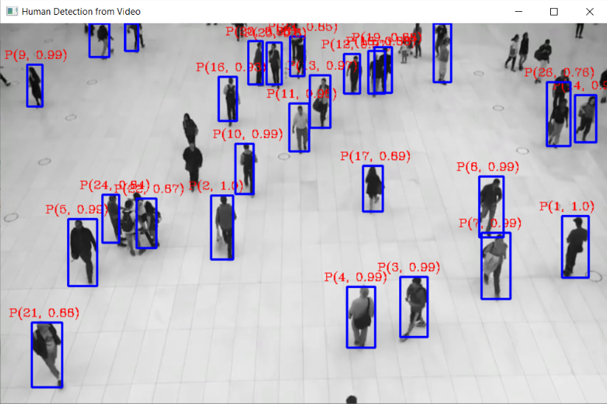
The sample screeshot accuracy increased with tensorflow is as follows:
Here for each detected human, the first term is count and the second term is the accuracy of detection.

Slide 20
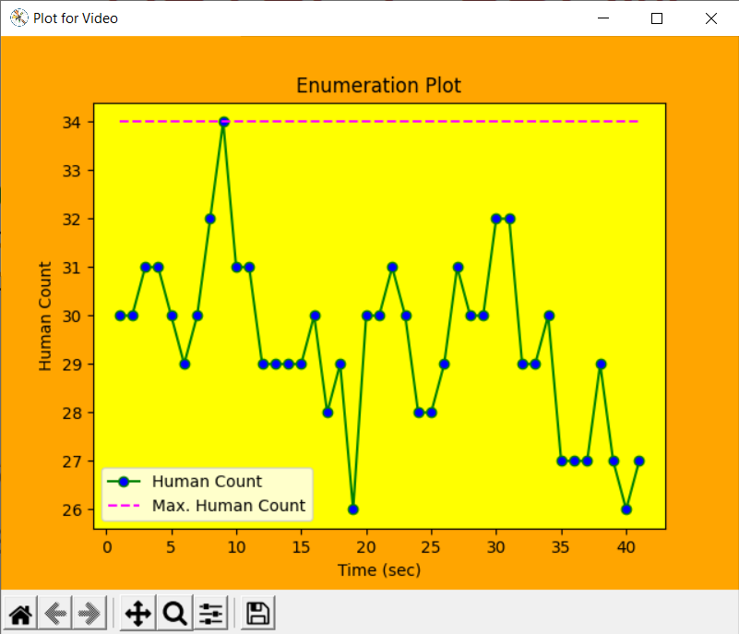
After detection and counting process, we plotted the two following plot using the data collected.
1st is Enumeration Plot :

Slide 21
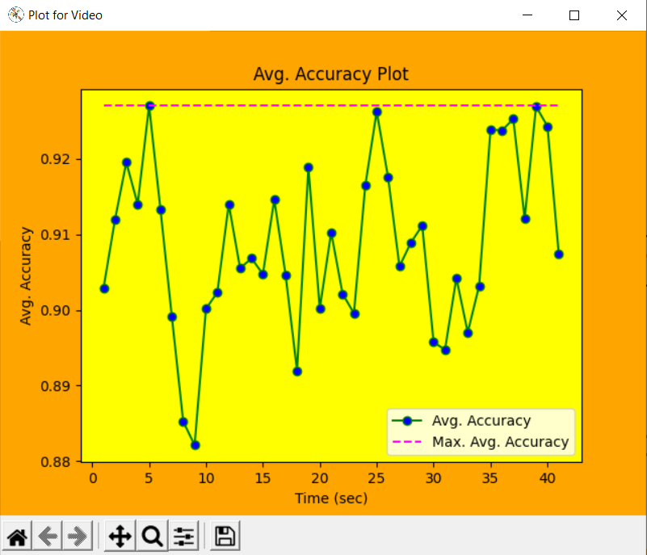
2nd is Avg. Accuracy plot :

Slide 22
And finally we are preparing a pdf report in which we are putting max. human detected, max. accuracy and max. average accuracy.
In the final pdf report, we are commenting according to the crowd status in that particular real time video.
Conclusively, the project was a real fun throughout the semester. We have learned a lot in the field of computer vision and object detection techniques.
this can be implemented in the commercial and rushed areas for having an accurate human data and for controlling the crowd.

